Slide 1
Permanent Support Housing
Heartland Housed
Mary Simons, M.S.
Nicole Johnson, Esq., MSW
Mindy Mitchell

Slide 2

Permanent Supportive Housing
Eligibility AND RECORDKEEPING
COORDINATED ENTRY and Referrals to psh
HARM REDUCTION
Housing First

Slide 3
Eligibility Requirements
Housing Requirements
The unit rent is under HUD’s published Fair Market Rent (FMR)
The unit meets HUD’s Housing Quality Standards (HQS) and Lead Based Paint Requirements
The unit is accessible
If leasing, there is an Environmental Review on file
People You Serve
The household is prioritized through the Coordinated Entry Process
The household’s homelessness has been verified
An adult household member has a documented disability
The household’s resident rent must be affordable

Slide 4
People you Serve
Must be unsheltered or residing in a shelter at the time of identification
Must have a documented disability
If the project is Dedicated Plus, households must have the longest time homeless or severe service needs as determined by the Coordinated Entry Process
If the project is dedicated to serving chronically homeless persons, there must be third party documentation for 9 of the 12 months for at least 75% of the participants

Slide 5
Definition of Chronic Homelessness
An individual is defined by HUD as “Chronically Homeless” if they have a disability and have lived in a shelter, safe haven, or place not meant for human habitation for 12 continuous months or for 4 separate occasions in the last three years (must total 12 months). Breaks in homelessness, while the individual is residing in an institutional care facility will not count as a break in homelessness. Additionally, an individual who is currently residing in an institutional care facility for less than 90 days and meets the above criteria for chronic homelessness may also be considered chronically homeless. Lastly, a family with an adult/minor head of household who meets the above-mentioned criteria may also be considered chronically homeless, despite changes in family composition (unless the chronically homeless head of household leaves the family).

Slide 6
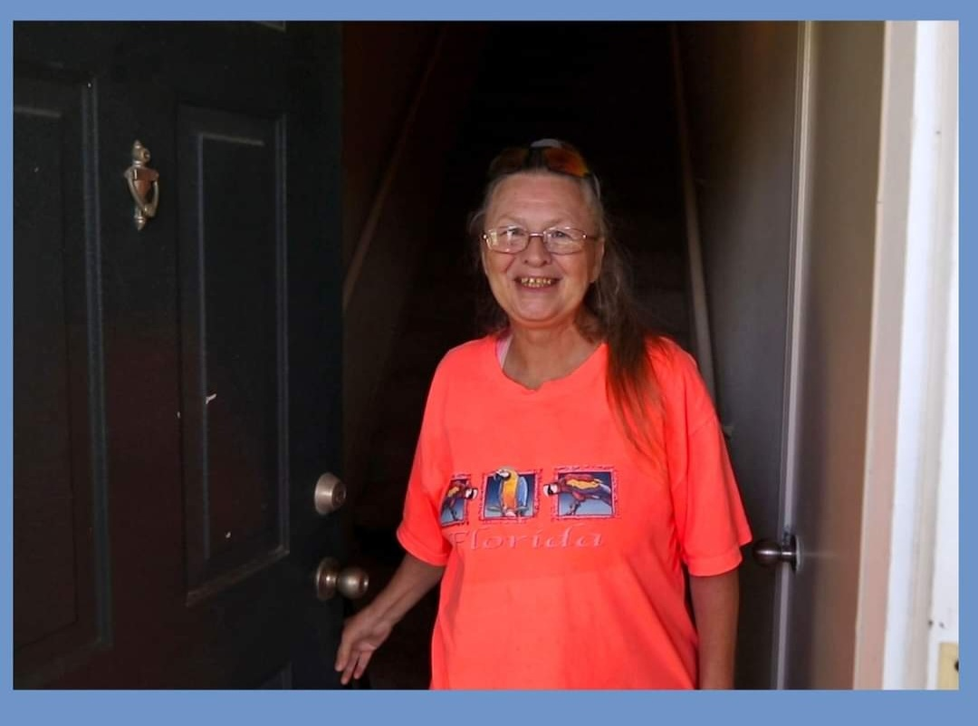
Time for Documentation
People should not remain homeless waiting for documentation
Time homeless can be completed within 180 days of housing in the PSH Program
Disability documentation can be completed within 90 days of housing in the PSH Program
Until proper documentation can be completed within the approved timeframes, self-certification for time homeless and case manager observation for disability will suffice

Slide 7
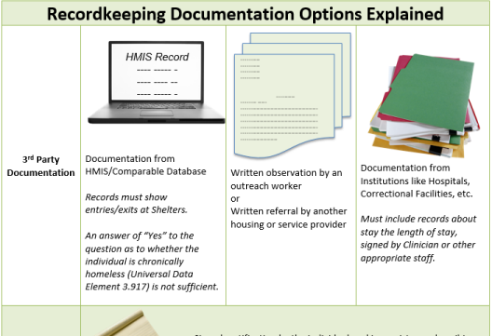
Time-Homeless Documentation
This presentation provides some sample recordkeeping tools for the Chronic Homelessness Definition. To review the exact language, please refer to 24 CFR Parts 91 & 578 and the HUD Exchange.

Slide 8
Notes about Third Party Documentation of Time Homeless
Third Party Documentation is preferred for documenting all the time someone has experienced homelessness.
All breaks in homelessness can all be Self-Certified.

Slide 9
Check the box to indicate where people were experiencing their homelessness:
Street, Shelter, Safe Have, or Institution for each month and note if documentation is attached.
The form is available at www.hudexchange.info- Sample Chronic Homelessness Documentation Checklist
Housing History
 | Month # 1 | Month # 2 | Month # 3 | Month # 4 | Month # 5 | Month # 6 | Month # 7 | Month # 8 | Month # 9 | Month # 10 | Month # 11 | Month # 12
Mo./Yr. | (Current Month)
Location Check all that Apply | ☐ Streets ☐ Shelter ☐ Safe Haven ☐ Inst. (<90 days) | ☐ Streets ☐ Shelter ☐ Safe Haven ☐ Inst. (<90 days) | ☐ Streets ☐ Shelter ☐ Safe Haven ☐ Inst. (<90 days) | ☐ Streets ☐ Shelter ☐ Safe Haven ☐ Inst. (<90 days) | ☐ Streets ☐ Shelter ☐ Safe Haven ☐ Inst. (<90 days) | ☐ Streets ☐ Shelter ☐ Safe Haven ☐ Inst. (<90 days) | ☐ Streets ☐ Shelter ☐ Safe Haven ☐ Inst. (<90 days) | ☐ Streets ☐ Shelter ☐ Safe Haven ☐ Inst. (<90 days) | ☐ Streets ☐ Shelter ☐ Safe Haven ☐ Inst. (<90 days) | ☐ Streets ☐ Shelter ☐ Safe Haven ☐ Inst. (<90 days) | ☐ Streets ☐ Shelter ☐ Safe Haven ☐ Inst. (<90 days) | ☐ Streets ☐ Shelter ☐ Safe Haven ☐ Inst. (<90 days)
Doc. Type Check One (Except Self-Cert. select both) | ☐ HMIS ☐ Obsv. By Outreach ☐ Comp. Database ☐ Discharge Paperwork ☐ Referral ☐ Self-Cert. ☐ Staff Doc. of Situation ☐ Doc. of steps to obtain evidence | ☐ HMIS ☐ Obsv. By Outreach ☐ Comp. Database ☐ Discharge Paperwork ☐ Referral ☐ Self-Cert. ☐ Staff Doc. of Situation ☐ Doc. of steps to obtain evidence | ☐ HMIS ☐ Obsv. By Outreach ☐ Comp. Database ☐ Discharge Paperwork ☐ Referral ☐ Self-Cert. ☐ Staff Doc. of Situation ☐ Doc. of steps to obtain evidence | ☐ HMIS ☐ Obsv. By Outreach ☐ Comp. Database ☐ Discharge Paperwork ☐ Referral ☐ Self-Cert. ☐ Staff Doc. of Situation ☐ Doc. of steps to obtain evidence | ☐ HMIS ☐ Obsv. By Outreach ☐ Comp. Database ☐ Discharge Paperwork ☐ Referral ☐ Self-Cert. ☐ Staff Doc. of Situation ☐ Doc. of steps to obtain evidence | ☐ HMIS ☐ Obsv. By Outreach ☐ Comp. Database ☐ Discharge Paperwork ☐ Referral ☐ Self-Cert. ☐ Staff Doc. of Situation ☐ Doc. of steps to obtain evidence | ☐ HMIS ☐ Obsv. By Outreach ☐ Comp. Database ☐ Discharge Paperwork ☐ Referral ☐ Self-Cert. ☐ Staff Doc. of Situation ☐ Doc. of steps to obtain evidence | ☐ HMIS ☐ Obsv. By Outreach ☐ Comp. Database ☐ Discharge Paperwork ☐ Referral ☐ Self-Cert. ☐ Staff Doc. of Situation ☐ Doc. of steps to obtain evidence | ☐ HMIS ☐ Obsv. By Outreach ☐ Comp. Database ☐ Discharge Paperwork ☐ Referral ☐ Self-Cert. ☐ Staff Doc. of Situation ☐ Doc. of steps to obtain evidence | ☐ HMIS ☐ Obsv. By Outreach ☐ Comp. Database ☐ Discharge Paperwork ☐ Referral ☐ Self-Cert. ☐ Staff Doc. of Situation ☐ Doc. of steps to obtain evidence | ☐ HMIS ☐ Obsv. By Outreach ☐ Comp. Database ☐ Discharge Paperwork ☐ Referral ☐ Self-Cert. ☐ Staff Doc. of Situation ☐ Doc. of steps to obtain evidence | ☐ HMIS ☐ Obsv. By Outreach ☐ Comp. Database ☐ Discharge Paperwork ☐ Referral ☐ Self-Cert. ☐ Staff Doc. of Situation ☐ Doc. of steps to obtain evidence
Doc. Att. | ☐Yes ☐No | ☐Yes ☐No | ☐Yes ☐No | ☐Yes ☐No | ☐Yes ☐No | ☐Yes ☐No | ☐Yes ☐No | ☐Yes ☐No | ☐Yes ☐No | ☐Yes ☐No | ☐Yes ☐No | ☐Yes ☐No

Slide 10
Breaks in Homelessness
Break Mo./Yr. & Description or N/A | Break 1: Break 2: Break 3: If there are additional breaks please detail and attach.
Notes
Attach Self Certification
Document any breaks in homelessness. Breaks will generally be self-certified and include any time in housing for over seven days. This is used when someone has been homeless 4 times in three years for a cumulative total of 12 months or more.

Slide 11
Definition of Disability
The term homeless individual with a disability' means an individual who is homeless, as defined in section 103, and has a disability that • Is expected to be long-continuing or of indefinite duration; O Substantially impedes the individual's ability to live independently; O Could be improved by the provision of more suitable housing conditions; and O Is a physical, mental, or emotional impairment, including an impairment caused by alcohol or drug abuse, post-traumatic stress disorder, or brain injury; • Is a developmental disability, as defined in section 102 of the Developmental Disabilities Assistance and Bill of Rights Act of 2000 (42 U.S.C. 15002); or • Is the disease of acquired immunodeficiency syndrome or any condition arising from the etiologic agency for acquired immunodeficiency syndrome.
It is required that an adult in the household have a documented disability to reside in PSH

Slide 12
Indicate the Type of Disability for the File
The head of household has been diagnosed with one or more of the following (check all that apply): ☐ Substance use disorder ☐ Serious mental illness ☐ Developmental disability ☐ Post-traumatic stress disorder ☐ Cognitive impairments resulting from brain injury ☐ Chronic physical illness or disability ☐ Other:

Slide 13
Attach Acceptable Documentation
Intake staff-recorded observation of disability that, no later than 45 days from the application for assistance, is accompanied by supporting evidence. Written verification of the disability from a licensed professional; Written verification from the Social Security Administration; or The receipt of a disability check

Slide 14
Documentation of Housing Requirements
Fair Market Rents
Rental and Utility Calculations
Inspections

Slide 15
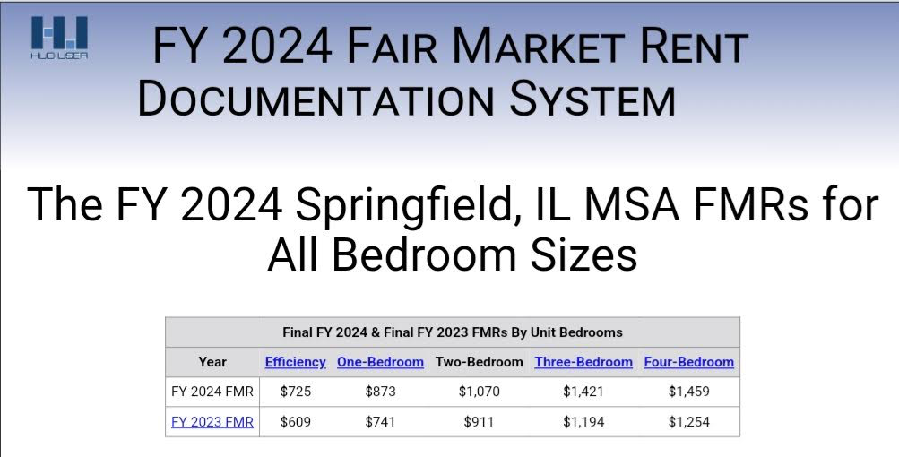
Rents must be under HUD’s FMR
Fair Market Rent (FMR) includes both rent and utilities. Calculate the cost of the unit by adding the rent and the utility allowance together and ensure the total is lower than HUD’s published FMR for the bedroom size.

Slide 16
Amount of The Resident’s Rent
The amount will be based on:
  number of people in household
  age of people in household
  anticipated income
  anticipated expenses
  anticipated allowances
  anticipated household-paid utilities

Slide 17
Rental Calculation
Determine Annual Income: All eligible income of family members over the age of 18
1
Determine the Dependent Deduction: Subtract $480 per dependent from the annual income
2
Determine Childcare Deduction: Subtract unreimbursed child-care costs for dependents under 13
3
Determine Disability Assistance Deduction: Subtract unreimbursed costs of necessary equipment or care
4
Determine Medical Expenses Deduction: Subtract unreimbursed medical for persons over the age of 62 or disabled
5
Determine Elderly/ Disabled Deduction: Deduct $400 for each person over the age of 62 or disabled
6
Determine the Adjusted Annual Income: Total income after subtracting deductions
7
Determine Resident Rent: Multiply the Adjusted Annual Income by .30.
8

Slide 18
Utilities: . CoC recipients are required to use their local Public Housing Authority’s (PHA) schedule of utility allowances per Notice CPD-17-11.
If utilities are not included in the rent but are the responsibility of the resident, a utility allowance for reasonable utility consumption must be subtracted from the rent
If the cost of utilities is less than the permitted monthly rental amount, the amount of rent must be reduced by the cost of utilities.
If the cost of utilities is greater than the permitted monthly rental amount, the household should receive a utilities reimbursement (View Notice CPD-17-11 for more information).

Slide 19
What if the program participant does not pay rent at all due to having no income, do they still receive a utility allowance reimbursement?
Yes, if the program participant is responsible for paying for their own utilities, they are eligible to receive a utility allowance. If, when the recipient or subrecipient deducts the reasonable monthly utility consumption amount from the program participant’s rent contribution or maximum occupancy charge amount (§ 578.77(b)-(c)), the calculation equals a number less than $0, then the recipient or subrecipient must provide a utility reimbursement to the program participant in accordance with the methods outlined in Section D of the CPD Notice 17-11.

Slide 20
The “utility reimbursement” may be paid using CoC program funds:
For program participants in TH or PSH projects, the utility reimbursement may be paid using operating funds.
For program participants receiving rental assistance, the utility reimbursement may be paid using rental assistance funds.

Slide 21
The Resident ‘s Total Rental Costs May Not Exceed:
30% of the Resident’s Adjusted Gross Income
10% of the Resident’s Gross Income
If the family is receiving payments for welfare assistance from a public agency and a part of the payments (adjusted in accordance with the family’s actual housing costs) is specifically designated by the agency to meet the family’s housing costs, the portion of the payments that is designated for housing costs.

Slide 22
Calculate Resident Rents:
At program entry
On the annual recertification date
As needed when there is an income change
Be sure to maintain detailed records of the calculations in the resident’s file

Slide 23
Inspections
To Be Done Prior to Move-In and Annually Thereafter

Slide 24
Housing Quality Standards
All units that will be paid for with CoC rental assistance or leasing funds must meet certain basic housing quality standards (HQS) prior to expending CoC funds on that unit.
All units must additionally meet state and local codes.

Slide 25
Housing Quality Standards (cont.)
Timing: The recipient or subrecipient must physically inspect all units prior to expending CoC funds and must continue to do so annually throughout the grant period.
Inspector: Inspectors do not need to be certified.
Addressing Deficiencies: The owner of the unit has 30 days to address and correct any deficiencies.
Documentation: The recipient or subrecipient must maintain documentation of compliance with HQS, including inspection reports.

Slide 26
Lead Based Paint
The recipient must screen for, disclose the existence of, and take reasonable precautions regarding the presence of lead-based paint in leased or assisted units constructed prior to 1978.

Slide 27
Environmental Review
All grants for acquisition, rehabilitation, conversion, leasing, repair, disposal, demolition, or construction must demonstrate that the project site is free of hazardous materials that could affect the health and safety of the occupants prior to expending CoC funds.
Costs of carrying out environmental review responsibilities is an eligible use of administrative funds.
Environmental reviews must be conducted by a “Responsible Entity” (a unit of local government).

Slide 28
Accessibility
Recipients and subrecipients must comply with the accessibility requirements of:
  Fair Housing Act
  Section 504 of the Rehabilitation Act of 1973
  Titles II and III of the Americans with Disabilities Act
  Housing and supportive services must be provided in the most integrated setting appropriate to the needs of persons with disabilities

Slide 29
Record Keeping Requirements

Slide 30
Benefits of Good Record Keeping
Allows you to keep track of what does and does not work
Helps you measure the services provided
Helps you know what takes up most of your time and checks your efficiency
Helps you make programming decisions
Strengthens your outcome reports
Lets you know when you need grant amendments
Makes it easier and quicker to apply and report to funders

Slide 31
Keys to Good Record Keeping
Document activities, maintain files, and monitor (at least) annually for compliance on all areas.
Obtain documentation from qualified source(s).
Design a system to maintain relevant records.

Slide 32
Confidentiality
All records containing protected identifying information of applicants or participants
The address or location of any housing of a program participant
Develop and implement written procedures to ensure security and confidentiality of:

Slide 33
Record Retention
All records pertaining to CoC funds must be retained for at least 5 years.
Exception: Eligibility documentation must be retained for 5 years after the final expenditure of all grant funds.

Slide 34
Levels of Recordkeeping
ORGANIZATIONAL RECORDKEEPING
PROJECT-LEVEL RECORDKEEPING
PARTICIPANT-LEVEL RECORDKEEPING
Notes:
Project Level Recordkeeping. When we cover this later, I will go into the difference between subrecipient and recipient – must be clear in agreement who is responsible for specific records. Important: should either monitor or not rely on another agencies records for project level recordkeeping and participant level recordkeeping

Slide 35
Organizational Record Keeping
Standard Operating Procedures
Conflicts of Interest
Homeless Participation
Faith-Based Activities
Affirmatively Furthering Fair Housing
Other Federal Requirements
Notes:
Anyone who receives or is a subrecipient of a grantee must have records covering these areas

Slide 36
Standard Operating Procedures
Establish and maintain standard operating procedures for ensuring that CoC funds are used in compliance with the CoC interim rule
Establish and maintain sufficient records to enable HUD to determine whether the recipient and its subrecipients are meeting the requirements of the CoC interim rule
Each recipient and subrecipient must:

Slide 37
Policies and Procedures
Program Operations
Financial Management
Grant Related
Staff & Board
Housing Related
Non-Discrimination
Program Participant Related

Slide 38
Conflicts of Interest
Evidence that recipients or subrecipients are rendering impartial CoC assistance
Evidence that no covered person is impaired in his or her objectivity in performing CoC-funded work, including by having a financial interest or benefits from a CoC-funded activity
Evidence that no covered person has obtained a financial interest or benefit from a CoC-funded activity, either for him or herself or for those with whom he or she has immediate family or business ties, during his or her tenure or during the one-year period following his or her tenure.
A copy of the personal conflict-of-interest policy developed and implemented to comply with the requirements
Records supporting exceptions to the personal conflict-of-interest prohibitions.
Each recipient must maintain records documenting compliance with the conflict-of-interest requirements, including:
Notes:
This includes employee, former employee, board member, (Ex.: CoC grant for leasing, Board member owns an apartment building and will rent it to for you cheap. Need to go through documentation process w/ HUD or not do it all)

Slide 39
Lived Experience Participation
At least one current or formerly homeless individual is on the recipient or subrecipient’s Board of Directors or other equivalent policymaking entity
Each recipient or subrecipient involves homeless individuals and families in employment, volunteer services, supportive services, or operation of the project to the extent practicable.
At a minimum, recipients and subrecipients must have policies related to the participation of people with lived experience and maintain records documenting compliance with requirements, including:

Slide 40
Faith Based Activities
Each recipient should maintain records documenting compliance, including:
No recipient or subrecipient discriminates against any client or prospective client on the basis of religious affiliation, belief or refusal to hold belief, or refusal to attend/participate in a religious practice.
Activities that involve overt religious content must perform such activities and services outside of programs supported with federal funds in both time and location.
Participation in religious activities must be voluntary on the part of clients benefiting from CoC funds.

Slide 41
Affirmatively Furthering Fair Housing
Each recipient should maintain records documenting compliance, including:
Copies of marketing, outreach, and other materials used to inform eligible persons of the program, showing:
  Evidence that the recipient or subrecipient affirmatively markets their housing or supportive services to eligible persons regardless of race, color, national origin, religion, sex, age, familial status, or handicap who are least likely to apply in the absence of special outreach
  Evidence that where a recipient encounters a condition or action that impedes fair housing choice for current or prospective program participants, the recipient provides such information to the Con Plan jurisdiction
  Evidence that participants are appraised of their rights and of available remedies under federal, State, and local fair housing and civil rights laws
  Evidence that the recipient and subrecipient are ensuring that their program’s housing and supportive services are provided in the most integrated setting appropriate to the needs of persons with disabilities

Slide 42
Other Federal Requirements
Environmental review
Section 6002 of the Solid Waste Disposal Act
Transparency Act Reporting
Coastal Barriers Resources Act of 1982
OMB Circulars
Lead-based paint
Audits
Section 3 of the Housing and Urban Development Act.
Each recipient should maintain records documenting compliance with 24 CFR 578.99, including:

Slide 43
Recipient/ Subrecipient Record Keeping
Project-Specific
Policies and Procedures
Services Provided
Housing Standards
Match
Subrecipients
and Contractors
Notes:
If you have multiple grants you will need keep these project level records for each of your grants

Slide 44
Program Specific Policies and Procedures
Eligible and ineligible costs
Eligible client for particular programs/program types
Restrictions on combining funds for specific activities
Reporting
Restrictive Covenants
Single occupancy agreements/leases/sub-leases
Residential Supervision
Coordinated Entry/Written Standards for Providing CoC Assistance
The grant administrator should maintain records regarding program-specific policies and procedures on all aspects of program operation:

Slide 45
Services Provided
Evidence of:
  An ongoing assessment of supportive services needed by residents of project and homeless persons using the project
  Availability of services
  Coordination of services needed to ensure long-term housing stability
Evidence of documentation of the types of supportive services provided and amounts spent on those services and
Evidence of at least an annual review of such documentation
Evidence that the service package is adjusted as necessary
Each recipient should maintain records documenting compliance, including:

Slide 46
Housing Standards
Each recipient should maintain records documenting compliance, including inspection reports regarding:
Lead based paint
Housing Quality Standards
Environmental Review
Records must show inspection prior to move in and at least annually during the grant period.

Slide 47
Match
Each recipient should maintain records documenting compliance
Source and use of contributions
Grant and fiscal year for which each matching contribution is counted
How the value placed on third party in-kind contributions was derived.
To the extent feasible, volunteer services must be supported by the same methods that the organization uses to support the allocation of regular personnel costs.

Slide 48
Subrecipients and Contractors
Each recipient should maintain records documenting compliance, including:
Solicitations of and agreements with subrecipients
Payment requests by and dates of payments made to subrecipients
Monitoring, sanctions, and corrective actions of subrecipients, including any monitoring findings and corrective actions required
Procurement contracts; and,
Compliance with procurement requirements

Slide 49
Participant Record Keeping
Homeless or At Risk Status
Other Program
Eligibility Verification
Program Participant Records
Annual Program
Participant Income
Notes:
Agency Level – Project Level – Participant Level

Slide 50
Eligibility Documentation
Maintain acceptable records regarding all aspects of eligibility:
Homelessness Status
Chronic Homelessness
Disability

Slide 51
Program Participant Income
HUD-mandated income evaluation form (rent calculation)
Source documents for the assets held by the program participant and income received prior to the date of evaluation
Each recipient receiving housing assistance where rent/occupancy charge is paid by program participants must document at program entry and annually:

Slide 52
Program Participant Records
Each recipient should maintain records documenting:
The services and assistance provided to that program participant, including:
  Evidence that the recipient or subrecipient has conducted an annual assessment and adjusted the service as necessary
  Evidence of case management services

Slide 53
Program Participant Records (cont.)
Each recipient should maintain records documenting:
  Evidence of compliance with the termination of assistance requirement.
  Due Process
  Copy of Program Rules and Termination Process before participant begins to receive assistance
  Written Notice – to participant containing clear statement of the reason for termination
  Review of Decision – participant given opportunity to present written or oral objections before a person who made or approved termination decision
  Prompt written notice of the final decision to the participant

Slide 54
Data Collection Points in HMIS
Record Creation
Project Entry
Update
Annual Assessment
Project Exit
Information must be collected for each of the applicable data points at the following times:
Notes:
Record Creation – at time of entry into HMIS
Project Entry – at time of entry into a project
Update – data collected at multiple points during enrollment (refers to any changes needed to be made)
Annual Assessment – data required annually (ex. PH projects)
Project Exit – data collected at the time participant is exiting project (always reflect the participant’s circumstances at exit

Slide 55
Annual Progress Reports (APR)
  All CoC Program recipients must complete a CoC APR in e-snaps.
  Recipients have 90 days from the end of their operating year to submit their APR to HUD through SAGE.
Annual Performance Reports (APR) - used by HUD to track the progress and accomplishments of projects funded by the Department.

Slide 56
Break
5 minutes

Slide 57

Housing First

Slide 58

Housing First is an approach where [people experiencing homelessness] are provided immediate access to housing and then offered the supportive services that may be needed to foster long-term stability and prevent a return to homelessness. This approach removes unnecessary barriers and assumes that supportive services are more effective in addressing needs when the individual or family is housed – when the daily stress of being homeless is taken out of the equation.
Ann Marie Oliva
Director, Office of Special Needs Assistance Programs
August 21, 2016

Slide 59
Key Concepts in Housing First
Homelessness is a housing problem and should be treated as such.
01
Persons should be stabilized in permanent housing as soon as possible – and then connected to resources to sustain that housing.
02
Underlying issues that contributed to a person’s homelessness are best addressed after that person is in a stable housing environment.
03
All persons experiencing homelessness are “housing ready.”
04

Slide 60
Housing First, Without Jargon
Accept participants regardless of sobriety.
Participants will be supported in ways that meet their individual needs.
Participants will not be evicted for not complying with their service plan.
Participants are not required to take classes before being placed in housing.

Slide 61
Why Benefits from Housing First?
People with complex service needs
Those often turned away from other affordable housing options
Those least likely to be able to proactively seek and obtain housing on their own

Slide 62
Lowering Barriers through Housing First
Access to housing does not include barriers such as:
  Sobriety or completion of treatment;
  Minimum income;
  Participation in services.
Households are not rejected because of:
  Poor credit or financial history;
  Criminal record;
  Poor or lack of rental history (e.g., evictions);
  Any behaviors considered to indicate a lack of “housing readiness.”

Slide 63
Housing First Philosophy Shift
Shifts the power dynamic from provider to client:
I literally have the power to decide if you get one juice box or two. (Rivianna Hyatt)
Shifts away from paternalism:
Our job is not to parent or “raise” youth, it’s to accompany them. (Derek Wentorf, CSH)
Shifts the burden for engagement to the provider:
If you make it engaging, they will engage. (Robin Meyer, NW Youth Services)

Slide 64

Harm Reduction

Slide 65

Definition of Harm Reduction
Harm Reduction focuses on meeting people where they are to lessen the risks associated with behaviors that can cause harm, such as substance use.
Success is measured by positive behavior change, no matter how big or small.
Harm reduction honors a person’s control and choice in defining their path but still promotes greater health and safety.

Slide 66
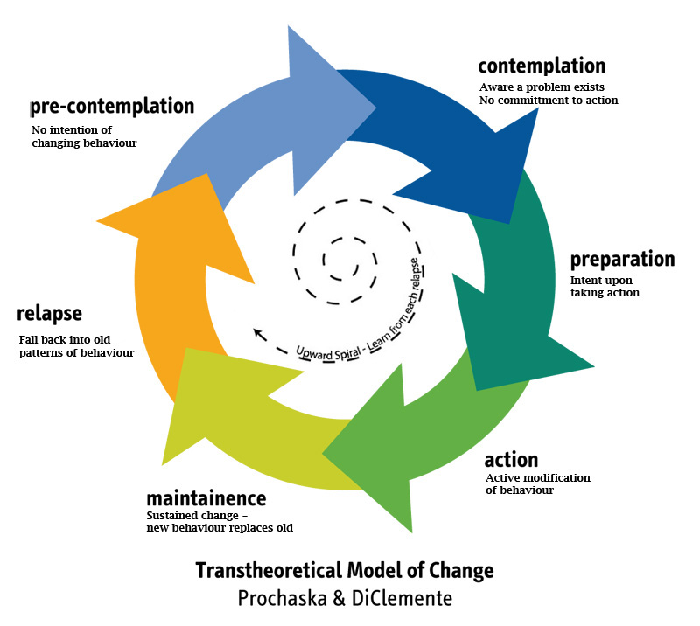

Stages of Change

Slide 67
Core Principles of Harm Reduction
Principle #1
Harm reduction is a pragmatic, nonjudgmental approach to addressing high-risk behaviors that are a fact of human society, with complex multi-faceted causes and varying degrees of harm.
Principle #2
The focus is on reducing harm, not consumption.
Principle #3
It is the individual’s choice to manage or mitigate the risk of high-risk behaviors.
Principle #4
The individual has a voice and deserves to be treated with dignity and respect.
Principle #5
Individuals are expected to take responsibility for the natural consequences of their behavior.

Slide 68
Key Characteristics of Harm Reduction
Remove Barriers
Access to programs/services is not contingent on participation/compliance.
Non-Coercive Engagement
It is the individual’s choice to manage or mitigate the risk of their high-risk behaviors.
Client-Driven Services
Work together to explore options and set goals. Feedback informs services.
Focus on Immediate Needs
Set goals that are realistic and attainable. Celebrate progress on small goals as success.
Information and Education
Provide education and information to make informed decisions. Connect to resources.
Building Relationships
Focus on developing strong, trusting relationships. Stick with clients who resist.
Personal Responsibility
Use natural consequences of behaviors as tools to move toward a desire for change.
Community Partnerships
Identify and develop partnerships or referral procedures for appropriate resources.

Slide 69
Harm Reduction is a Housing First Strategy
Harm reduction is integral to the positive outcomes of Housing First programs

Slide 70

What about Costumer Service?

Slide 71
Top Reasons Clients Disengage and/or Are Pushed from Services
Services don’t meet the client’s most pressing needs
Engagement is not perceived as the best use of limited resources
Fear of negative consequences to engagement
The expected frequency of engagement doesn’t align with the client’s needs
Lack of capacity to engage

Slide 72
Referrals to PSH from Coordinated Entry
Make sure that Coordinated Entry Personnel know if your program is
DEDICATED TO PEOPLE EXPERIENCING CHRONIC HOMELESSNESS
Or
DEDICATED PLUS

Slide 73
Coordinated Entry
CoC requirement to streamline entry to homeless housing and services projects
HUD’s primary goals:
  Assistance be allocated as effectively as possible
  Assistance be easily accessible no matter where or how people present
Helps communities prioritize assistance based on vulnerability and severity of service needs
Provides information about service needs and gaps

Slide 74
Heartland HOUSED Coordinated Entry Priorities
Chronically homeless individuals and families with the longest histories of homelessness AND the most severe service needs as documented in the Coordinated Entry System
Chronically homeless individuals and families with the most severe service needs as documented in the Coordinated Entry System
Chronically homeless individuals and families with the longest histories of homelessness as documented in the Coordinated Entry System
Chronically homeless individuals and families with the greatest barriers and risks as documented by the Coordinated Entry assessment process
Households with the earliest date of the Coordinated Entry assessment

Slide 75
Housing First in PSH

Slide 76
Housing First Principles
Homelessness is primarily a housing problem.
Housing is a basic human right to which all persons are entitled without qualification.
Homeless persons should be returned to or stabilized in permanent housing as soon as possible and connected to the resources required to sustain that housing.
Underlying issues that contributed to a person’s homelessness are best addressed once that person is in a stable housing environment.
Independent living empowers participants to meet personal challenges and fosters self-reliance.

Slide 77
Housing First at the Program/Project Level
5 Core Elements:
No requirement regarding sobriety, participation in services for acceptance into program
No requirement regarding financial/rental/criminal history
Accept Coordinated Entry referrals to house people directly from streets and shelters
No requirement regarding participation in services for continued tenancy; emphasis on engagement and problem-solving
Use of alcohol or drugs is not a basis for eviction

Slide 78
Model: Housing First at the Program/Project Level
5 Advanced Elements:
Prioritize vulnerability
Provide client rent payments
Case managers/service coordinators employ evidence-based practices
Services informed by harm reduction philosophy
Include special accommodations for persons with disabilities in units

Slide 79
Harm Reduction

Slide 81
Core Principles of Harm Reduction
1
2
3
4
5
Principle #1
Harm reduction is a pragmatic, nonjudgmental approach to addressing high-risk behaviors that are a fact of human society, with complex multi-faceted causes and varying degrees of harm.
Principle #2
The focus is on reducing harm, not consumption.
Principle #3
It is the individual’s choice to manage or mitigate the risk of high-risk behaviors.
Principle #4
The individual has a voice and deserves to be treated with dignity and respect.
Principle #5 (discussion)
Individuals are expected to take responsibility for the natural consequences of their behavior.
Notes:
What does taking responsibility look like for you?
We’ve all messed up? What do we do?
Apologize? Find out what can be done to repair? Plan for the future.
Consequences are different based on the resources we have to avoid them, blunt them, ride them out… MANY wealthy people overuse substances or have SMI, but the consequences they experience as a result are *RARELY* homelessness. Why?

Slide 82
Key Characteristics of Harm Reduction
1
2
3
4
5
6
7
Remove Barriers
Access to programs/services is not contingent on participation/compliance
Non-Coercive Engagement
It is the individual’s choice to manage or mitigate the risk of their high-risk behaviors
Client-Driven Services
Work together to explore options and set goals; Feedback informs services
Focus on Immediate Needs
Set goals that are realistic and attainable; Celebrate progress on small goals as success
Information and Education
Provide education and information to make informed decisions; Connect to resources
Building Relationships
Focus on developing strong, trusting relationships; Stick with clients who resist
Personal Responsibility
Use natural consequences of behaviors as tools to move toward a desire for change
Community Partnerships
Identify and develop partnerships or referral procedures for appropriate resources,
8
Notes:
As you can see – some of the key characteristics of harm reduction are similar to those of housing first, such as low-barrier, client-driven services – in a nutshell, “Don’t Force – Remember Choice” The other key to providing housing first/harm reduction focused services is to build relationships – with the client, with landlords/owners/property managers, with community partners.

Slide 83
Who Benefits from Harm Reduction?
Because of its flexible approach, harm reduction strategies are appropriate for numerous homeless subpopulations, including:
Adults
Families
Youth
Harm reduction is a service model for individuals who engage in high-risk behaviors, including:
Drug use
Alcohol use
Higher-risk sexual activity
Sex work
Etc.

Slide 84
Why Harm Reduction?
1
Housing First
2
Positive Client Outcomes
3
Benefits to Providers

Slide 85
Intersection with Housing First
Housing First is a harm reduction strategy
Harm reduction is integral to the positive outcomes of Housing First programs, including:
  Residential stability
  Social benefits
  Cost effectiveness
Notes:
Cost effectiveness and pragmatism are important here, and part of the shift in our philosophical approach that is necessary to really move the needle on homelessness in our community. Abstinence-only programs have a really low success rate when it comes to the goal of permanent housing and no returns to homelessness. They also have a low success rate when it comes to sobriety, btw. But if our goal is ending homelessness, putting a lot of resources into abstinence-only approaches isn’t actually cost-effective.

